Slide 1
CENTER FOR DEVELOPMENT OF ADVANCED COMPUTING,KHARGHAR
POST GRADUATE DIPLOMA IN ADVANCED COMPUTING
Project Review
On
Competitive Exam Guidance Portal
Group Members:
Abhishek Khedulkar Kuldip Patil
Janabai Davangave Smita Kadu
Shubham Jadhav Nihal Mahaldar
Azaz Mohmmad
Project Guide:
Mr. Akshay Kumar

Slide 2
INTRODUCTION
Competitive Exam Guidance Portal is a web application which provides an interface through which candidate can view the eligible exams according to entered criteria.
The proposed system eliminates the need of searching the exams individually instead they can all exams information in this web application only.
It also provides an interface through which candidate can subscribe for exams notification as an alert.

Slide 3
Objective
To search the appropriate competitive exams according to candidate educational criteria.
To provide alerts of exams through email.
To provide exam related references of particular exam.

Slide 4
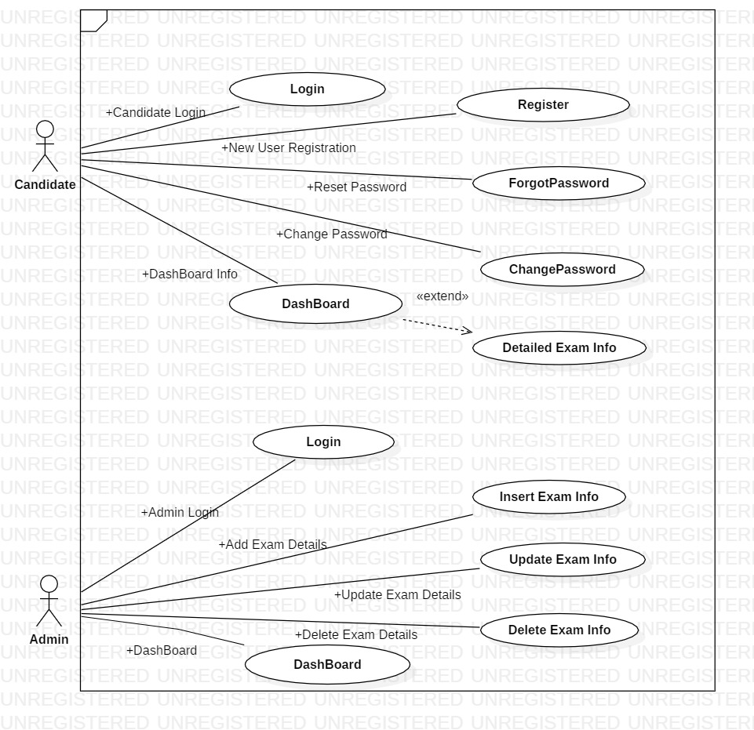
USE CASE DIAGRAM

Slide 5
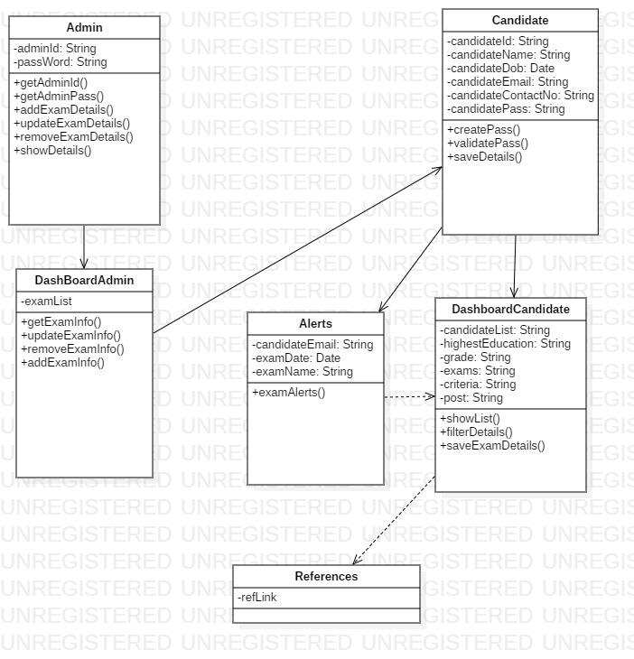
CLASS DIAGRAM

Slide 6
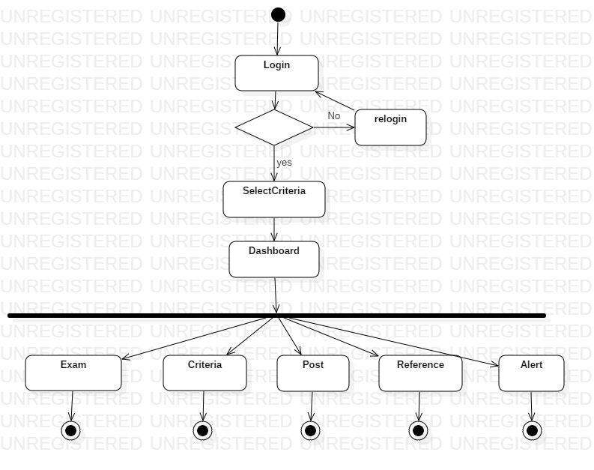
USER - ACTIVITY DIAGRAM

Slide 7
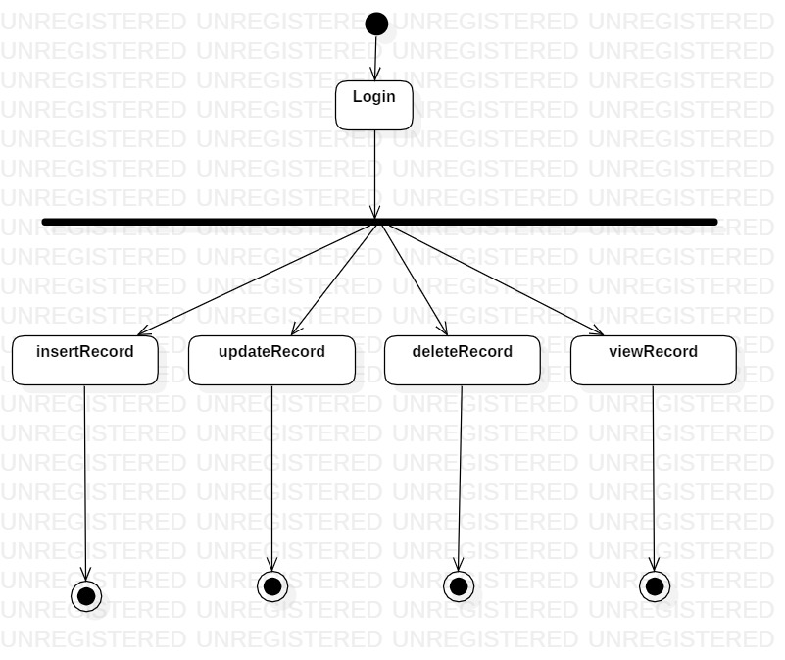
ADMIN - ACTIVITY DIAGRAM

Slide 8
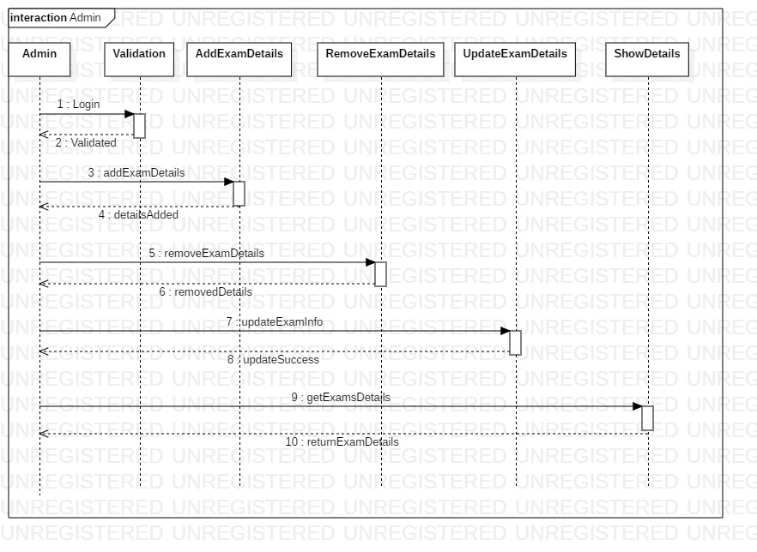
ADMIN - SEQUENCE DIAGRAM

Slide 9
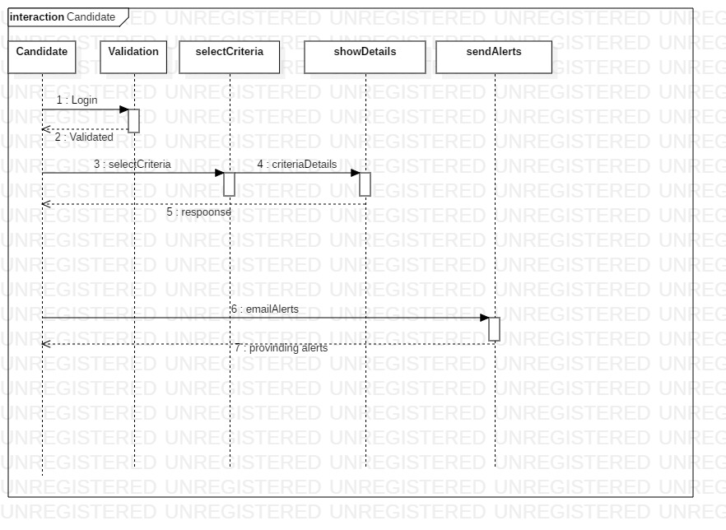
USER - SEQUENCE DIAGRAM

Slide 10
FUTURE SCOPE
Coaching center collaboration .
Hosting live session.
Scholarships
Mock test for candidates
Peer group study feature
Online question and answer session

Slide 11
Hardware Requirements:
Processor – Above Pentium 4, with clock speed of 2.0 GHz
RAM – 1 GB or above
Hard Disk – Free disk space of above 1 GB
Software Requirements:
Front-end: HTML, CSS, Bootstrap.
Back-end: MySQL, java, Spring, hibernate.
Supported Tools:
Visual Code Studio, eclipse Jee 2018-09, MySQL Workbench.

Slide 12
REFERENCES
http://www.freejobalert.com/
https://spring.io/
https://www.java.com/en/
https://stackoverflow.com/
https://getbootstrap.com/
https://hibernate.org/

Slide 13
THANK YOU

